Slide 1
1989
2003
2017
2022
Notes:
Divide students into four groups – each group is assigned one “year” to investigate what space weather events happened that year (theres a famous event in each)

Slide 2
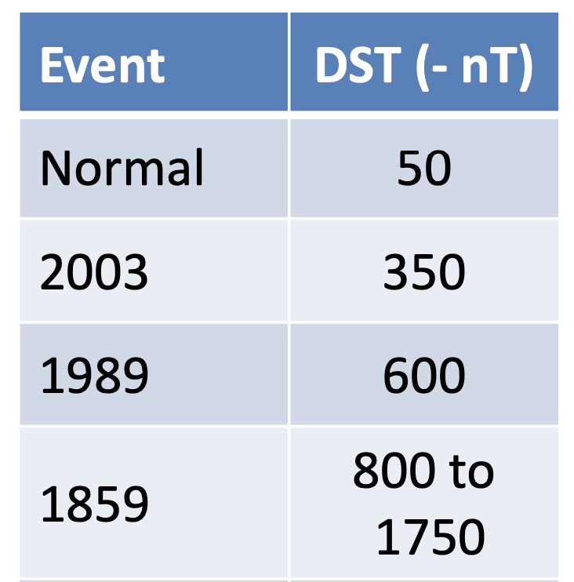
1859
Notes:
After each group presents their own investigations you can show them the Carrington event!
The 1859 event is the largest documented impact of a solar storm on Earth. It is an example of what in weather forecasting is called a 1 in 100 year event (that statistically has a 1-percent chance of occurring in any given year)
The Carrington Event of 1859 was the first documented event of a solar flare impacting Earth. It is named after Richard Carrington, the solar astronomer who witnessed the event through his private observatory telescope and sketched the sun's sunspots at the time (top image).
The Carrington solar storm event sparked major aurora displays that were visible as far south as the Caribbean (image below). It also caused severe interruptions in global telegraph communications, even shocking some telegraph operators and sparking fires when discharges from the lines ignited telegraph paper.
The impacts if a storm of this size today would definitely eclipse any of the examples the students have studied! See table of Disturbance Storm Time Index (index of magnetic activity on Earth) – hard to know how strong the storm was but the guessed range is much larger than a normal day or the 2003 or 1989 storms!

Slide 3
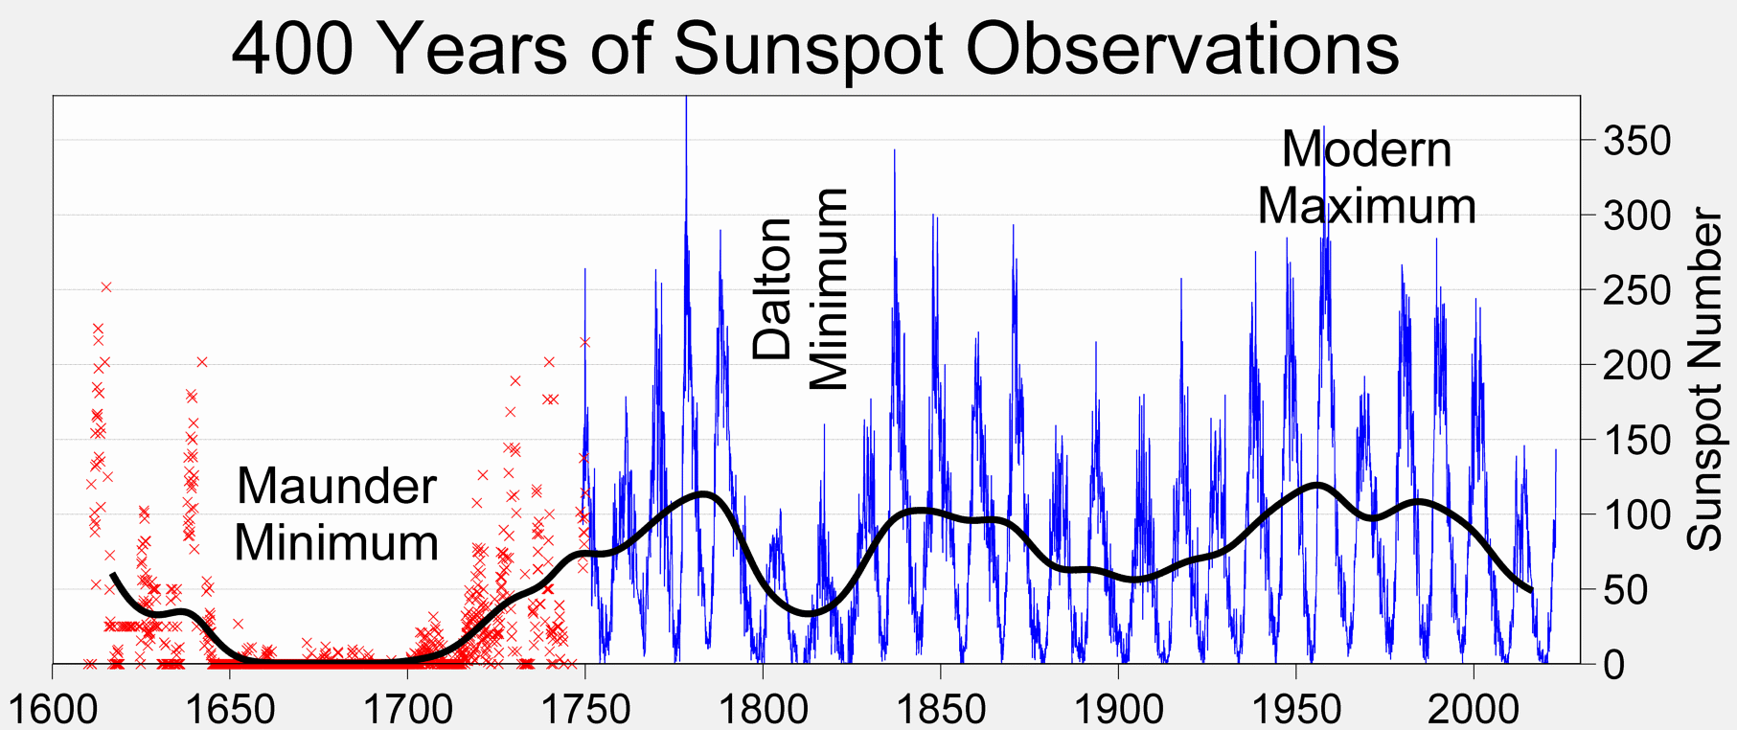
Notes:
The Halloween storms occurred during a time in the solar cycle when solar activity should be relatively quiet — about two to three years after the solar maximum.
The 1859 event occurred at the height of solar minimum!

Slide 4
1989
Notes:
Each slide provide some extra information on the different events in case the students don’t get them all
In March 1989, a powerful geomagnetic storm caused a power blackout in Canada that left six million people without electricity for nine hours. The storm disrupted electric power transmission from the Hydro Québec generating station and even melted some power transformers in New Jersey (pictures above).
It also caused communications blackouts and the loss of positional knowledge for over 1,000 space objects for nearly a week.
It also temporarily affected sensors on a fuel tank on the Space Shuttle Discovery. During the storm, astronauts on the International Space Station had to shelter in the furthest interior to shield themselves, but still reported seeing flashes with their eyes closed.

Slide 5
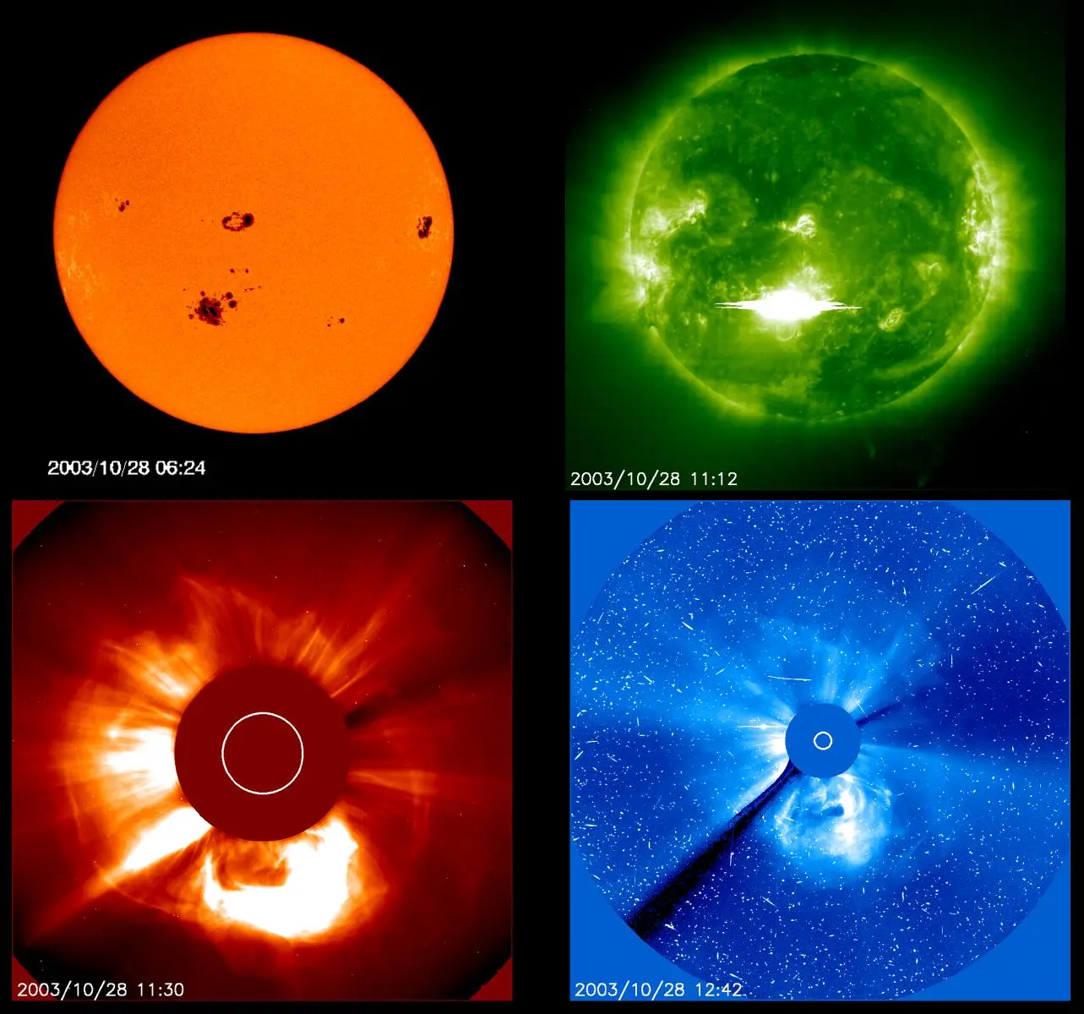
2003
Notes:
Famously known as the Halloween storms as it was over that period in 2003!
These solar storms caused aircraft to be re-routed, affected satellite systems and caused power outages in Sweden. During the height of the storms about 10% of the active operational satellite fleet – almost 50 satellites – reported anomalies, including one total loss and 10 cases of loss of operational service for more than a day. GPS systems were seriously affected including those used for surveying, deep-sea and land drilling, and some airline flights.
One particular flare was so intense it overwhelmed the spacecraft sensor measuring it on the Solar and Heliospheric Observatory (SOHO – images from it on screen) spacecraft and it temporarily failed during the storm!

Slide 6
2017
Notes:
During 4–10 September 2017 a ”trio” of natural hazards occurred all at once in the Gulf of Mexico. Three hurricanes hit one after the other (Katja, Jose, and Irma) and there were also two major earthquakes and multiple large solar flares.
The conjunction of these natural phenomena were close to creating a worst-case scenario in terms of civil protection reaction.
The solar flares caused a strong radio blackout over most the sunlit side of Earth (top right plot – red is bad!), including the area of the hurricanes and earthquakes! High frequency radio blackouts caused by the flares disrupted emergency communications vital to recovery efforts following Hurricane Irma.

Slide 7
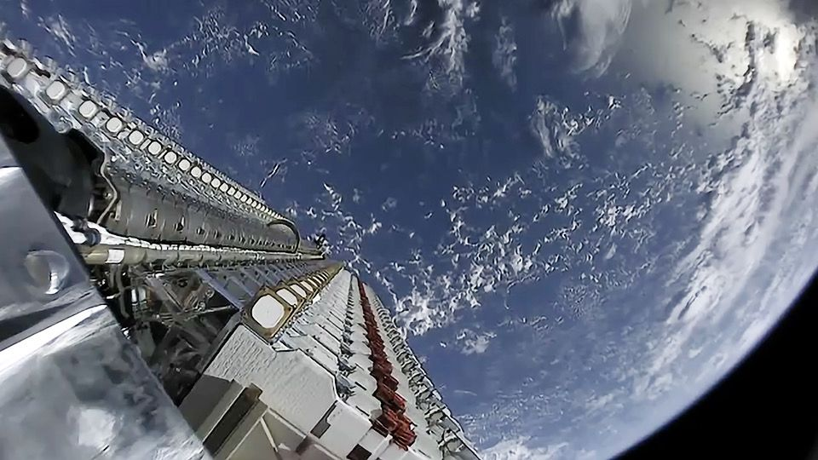
2022
Notes:
In February 2022, SpaceX witnessed the destructive power of the sun when a geomagnetic storm destroyed up to 40 Starlink satellites worth over $50 million shortly after deployment.
Starlink satellites (and other low-Earth orbit satellites) are particularly vulnerable to geomagnetic storms because they are released into very low-altitude orbits (between 60 and 120 miles (100 to 200 km), and they rely on onboard engines to overcome the force of drag, raising themselves to a final altitude of about 350 miles (550 km).
During a geomagnetic storm, Earth's atmosphere absorbs energy from the storms, heats up and expands upwards, leading to a significantly denser thermosphere that extends from about 50 miles (80 km) to approximately 600 miles (1,000 km) above the Earth's surface. A denser thermosphere means more drag which can be an issue for satellites.
This is what happened in February 2022 when the batch of recently released Starlink satellites failed to overcome the increased drag caused by the geomagnetic storm and began to fall back to Earth, eventually burning up in the atmosphere.

